Slide 1
BUSINESS LOCATION BY NUMBER OF EMPLOYEES
Source: Dr Andy Cosh, University of Cambridge, 2018. Contains Ordnance Survey data © Crown copyright and database right 2018.

Slide 2
NON KNOWLEDGE INTENSIVE SERVICES SECTORS

Slide 3
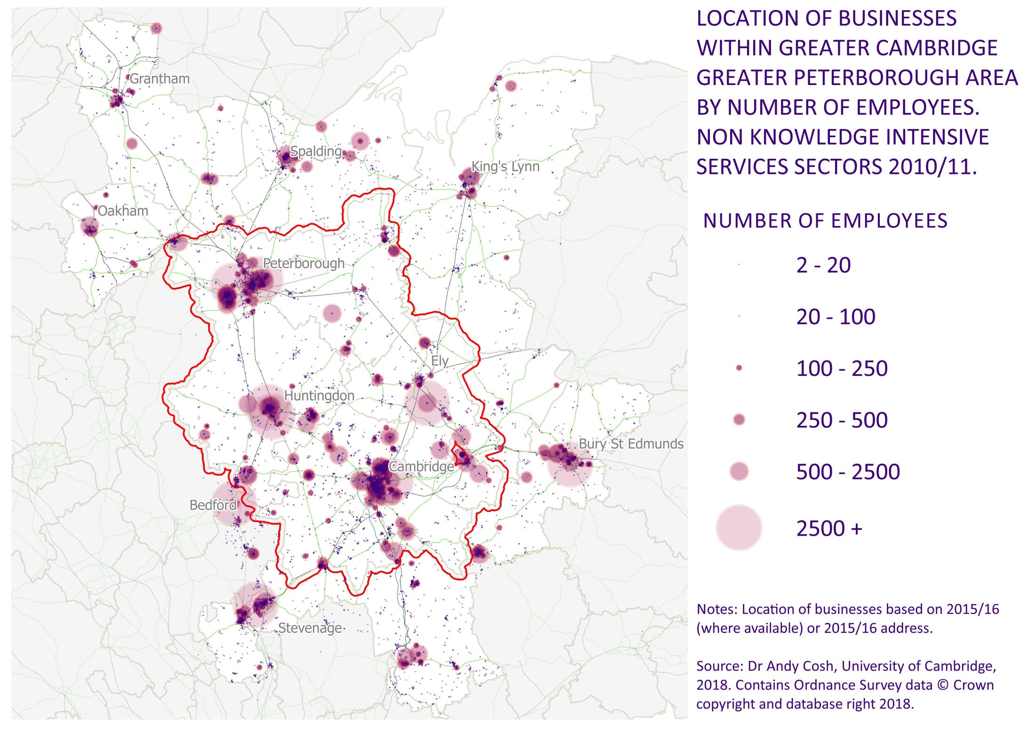

Slide 4
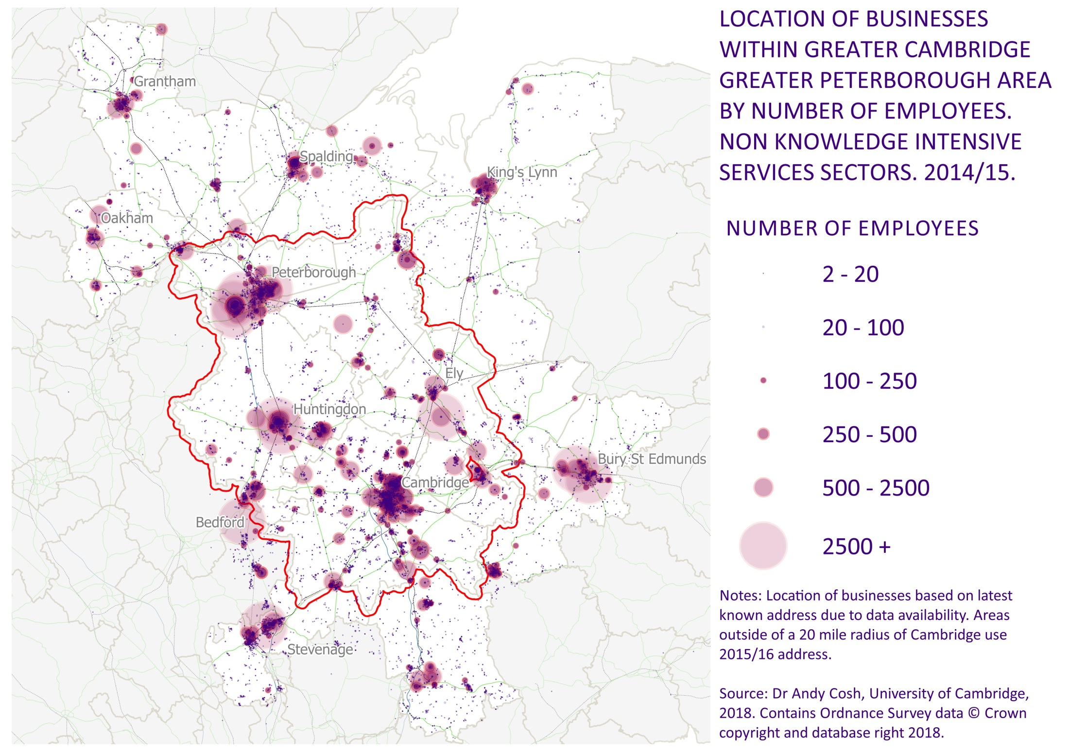

Slide 5
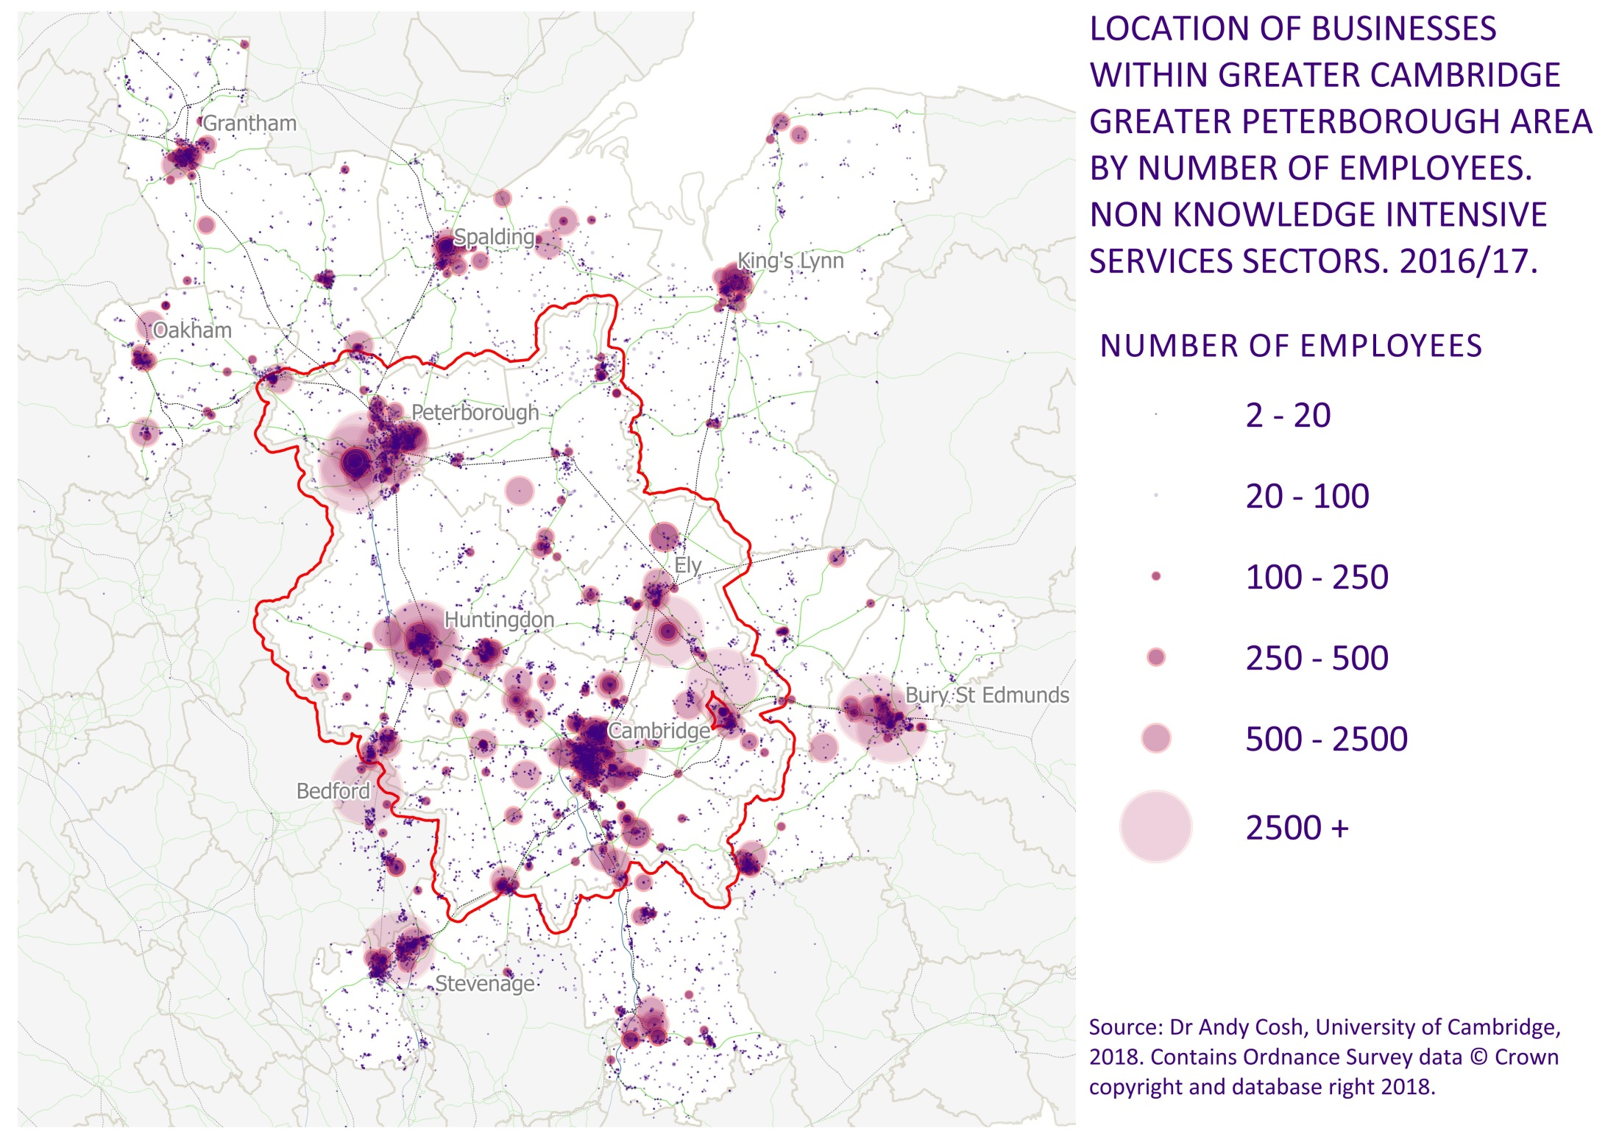

Slide 6
INFORMATION TECHNOLOGY AND COMMS SECTOR

Slide 7
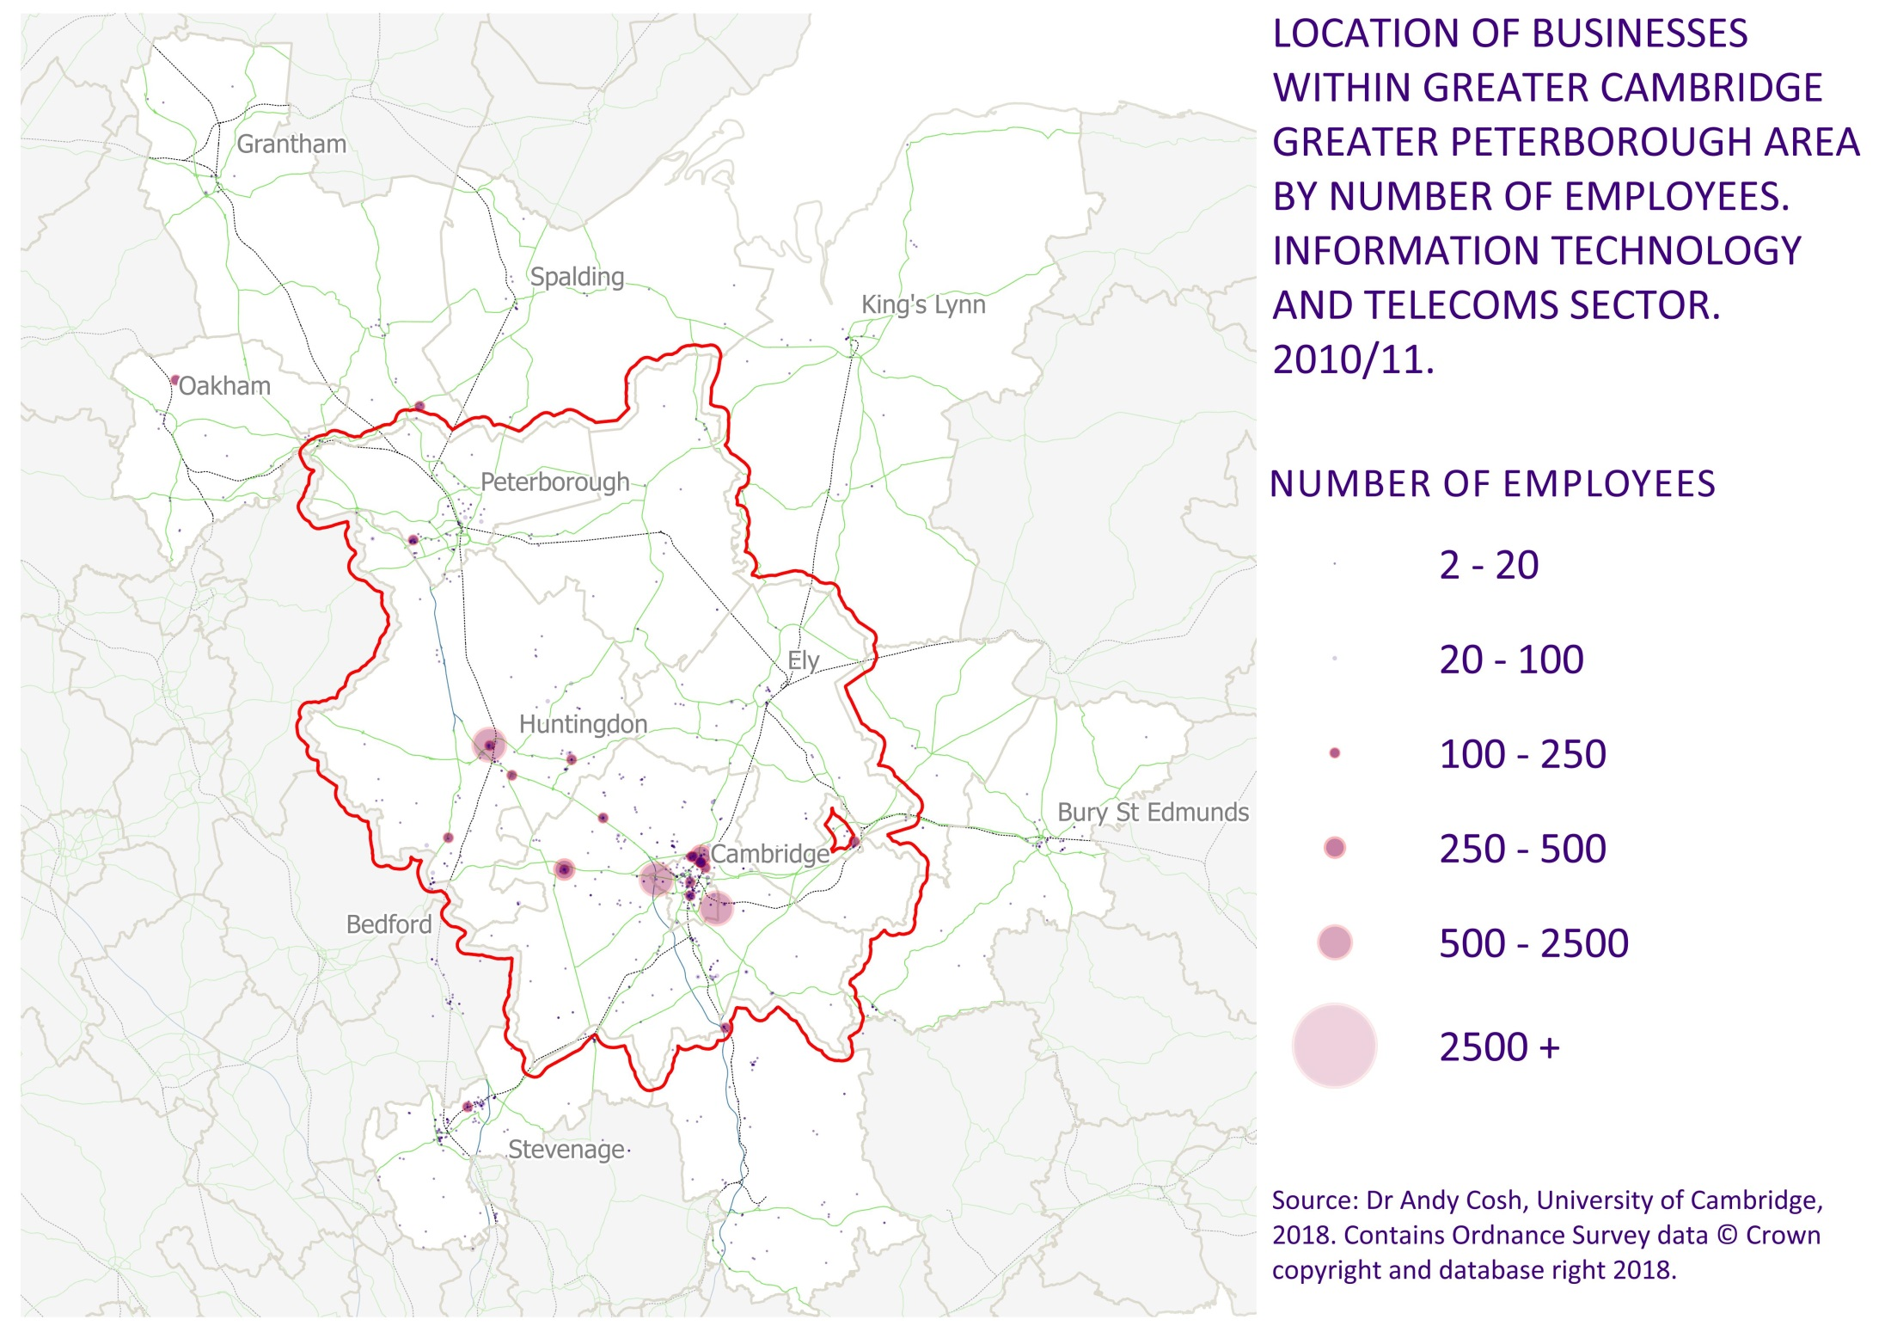

Slide 8
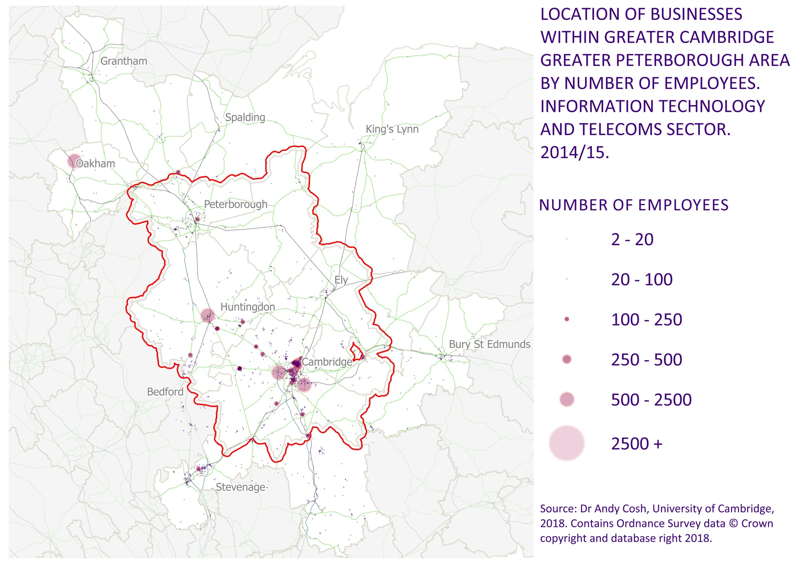

Slide 9


Slide 10
LIFE SCIENCES AND HEALTHCARE SECTOR

Slide 11
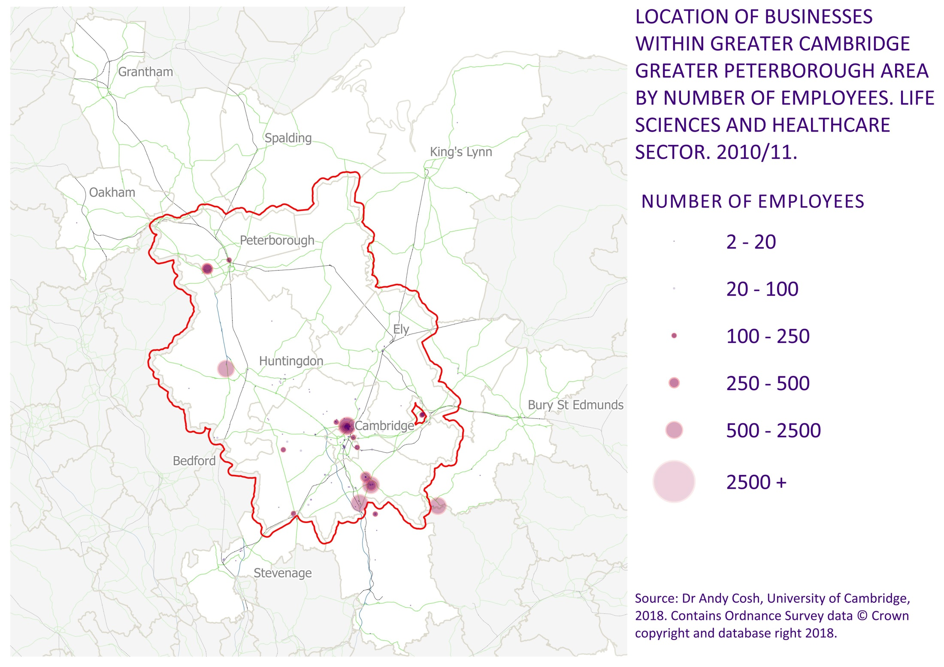

Slide 12


Slide 13


Slide 14
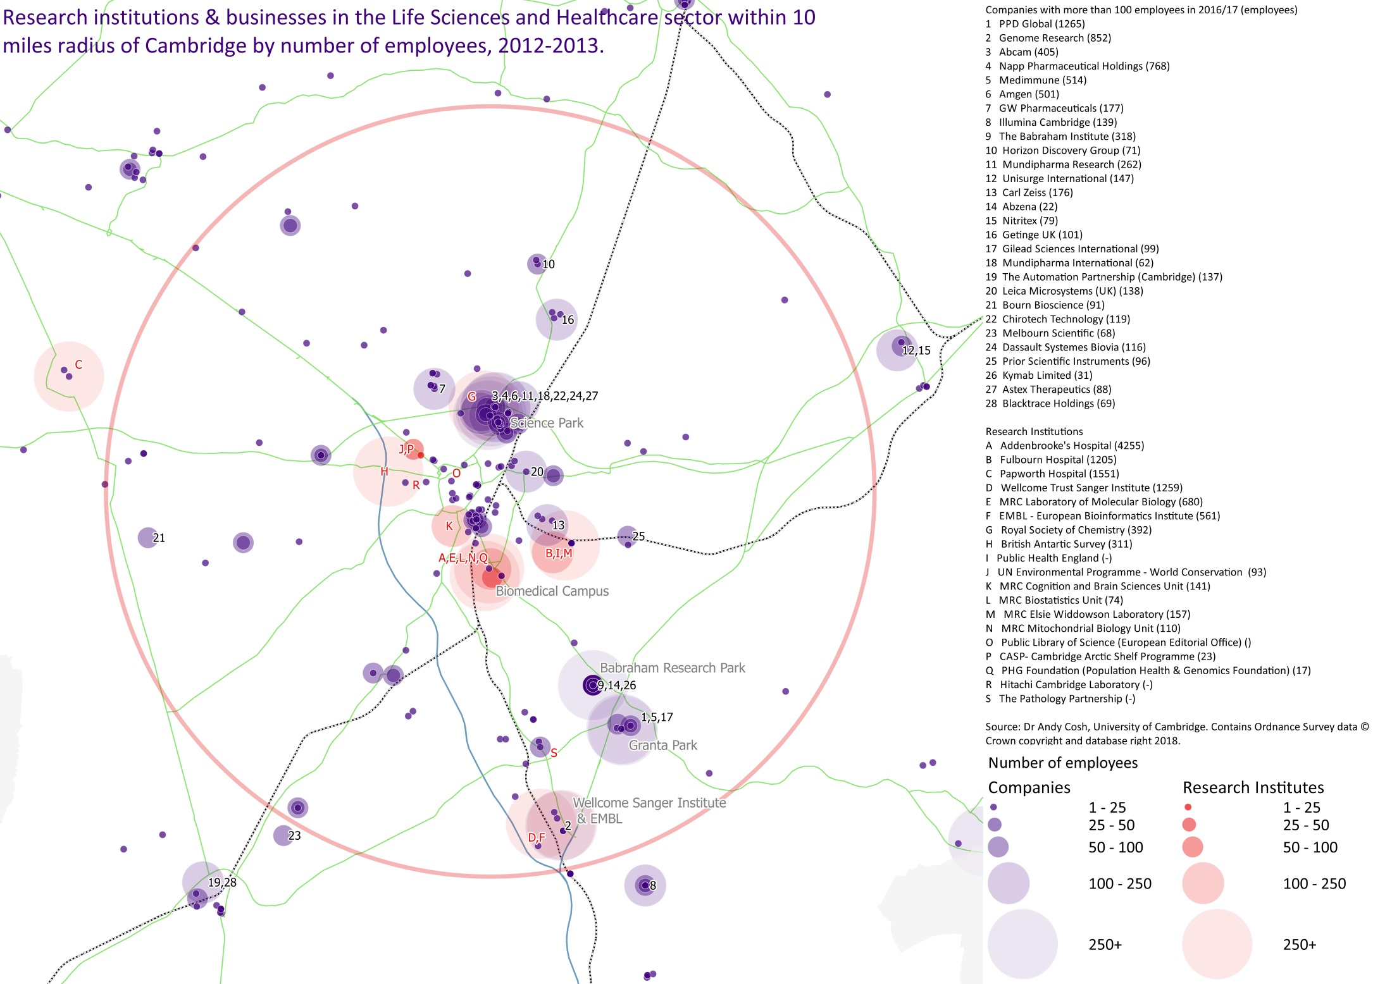

Slide 15
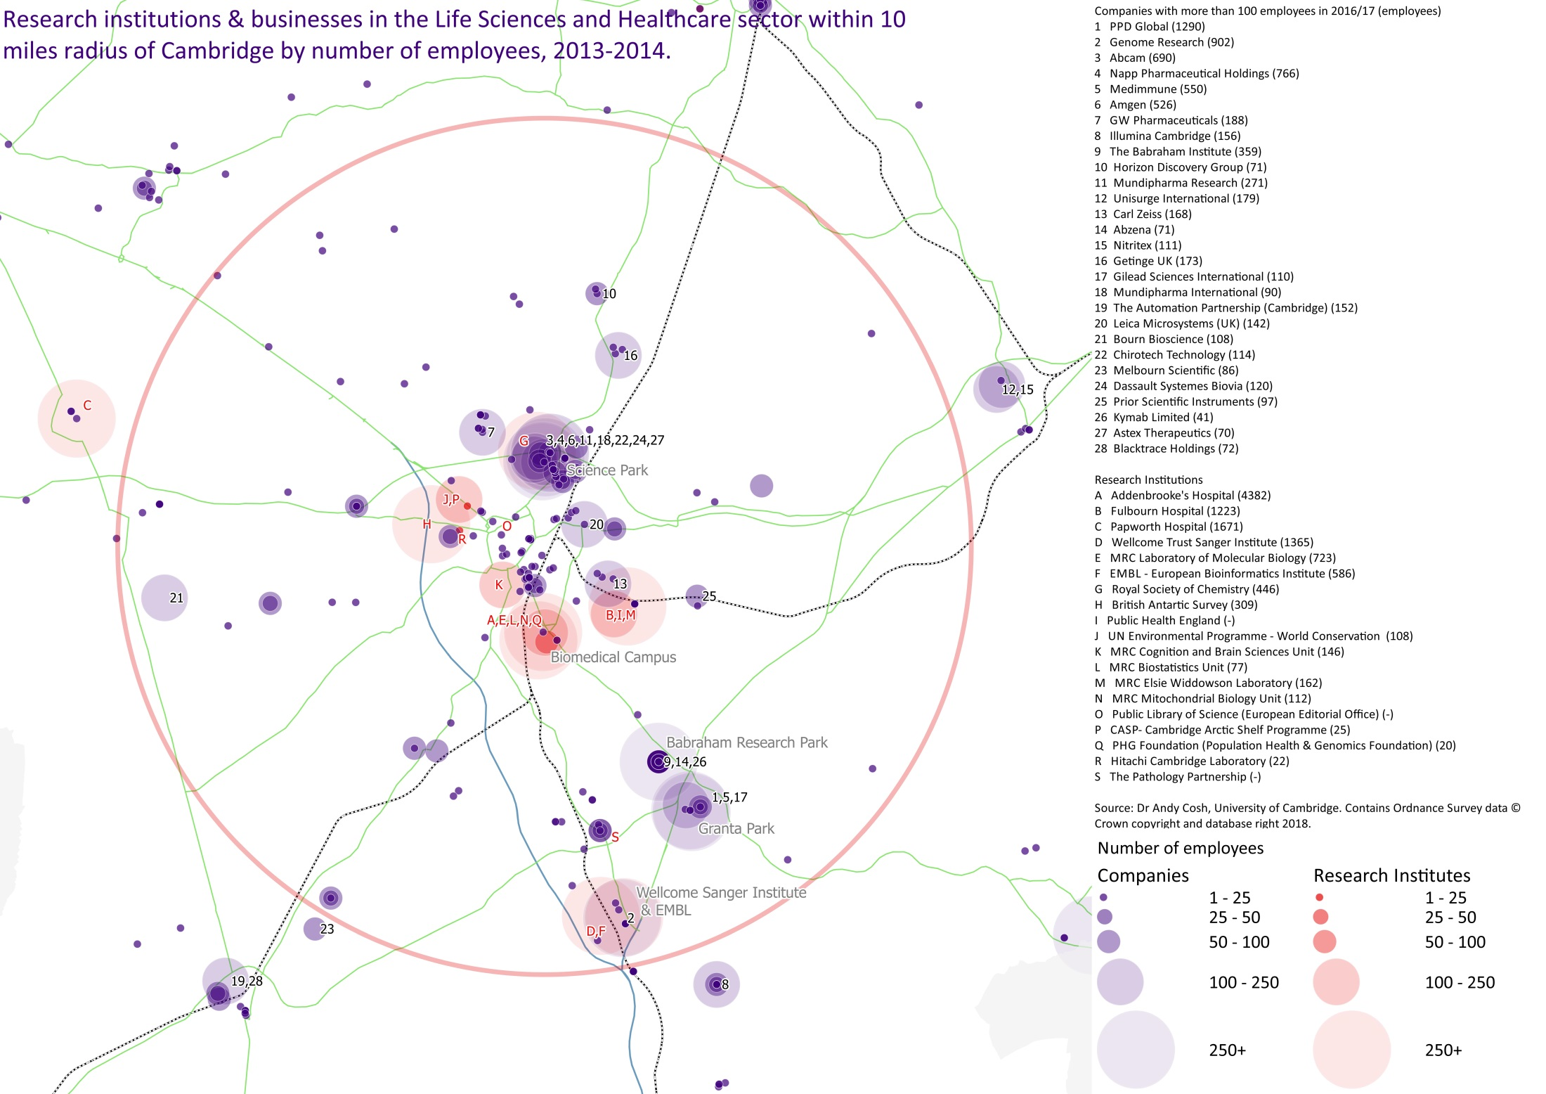

Slide 16
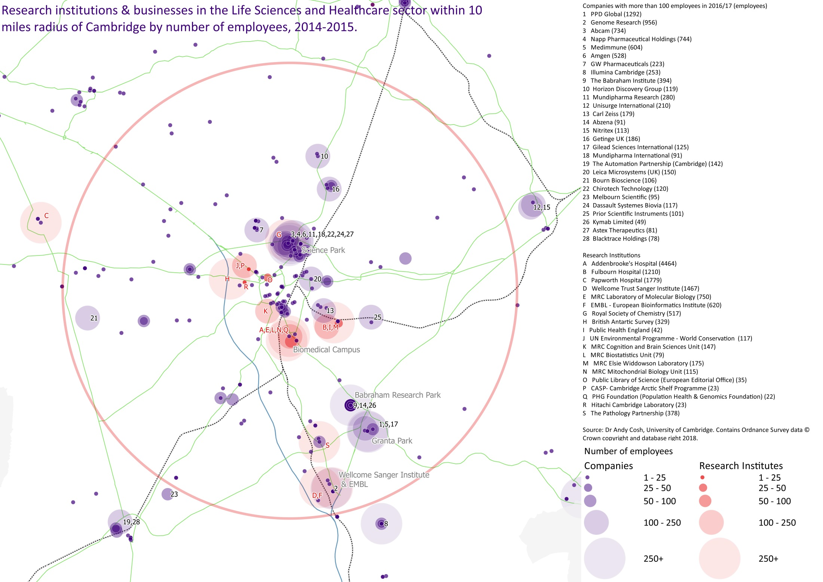

Slide 17
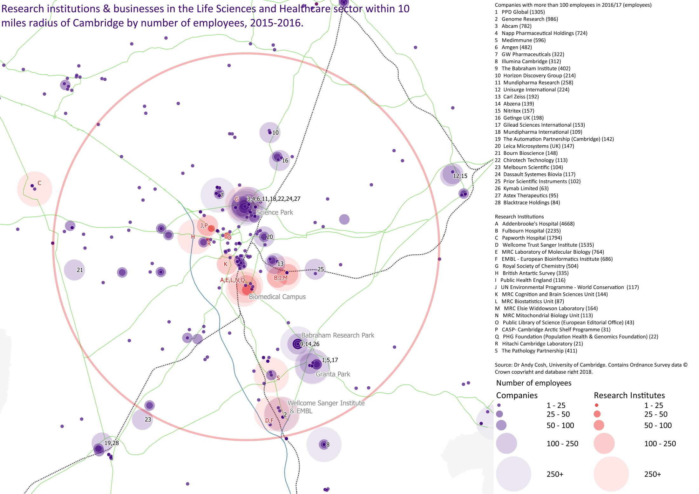

Slide 18
